Slide 1
Module 2: Linux session
Getting started
2: Linux session
3: Using files and directories
4: Editing text

Slide 2
Contents
System access
Shells
Command line structure
Help
Fact finding commands

Slide 3
System access
Logging in

Slide 4
Gaining access to the system
Notes:
This module begins by introducing the typical login sequence for accessing a Linux system. There are three main login methods: two local and one remote.
For local users, access can be via a graphical login (GUI) or a console (non-GUI) login.
The graphical login is managed by processes like gdm or xdm, prompting for a username and password before launching a window manager such as GNOME, KDE, MATE, or Cinnamon.
The console login is handled by the getty (get tty) process, which provides access to multiple virtual consoles. If a graphical session is running, switching to a console may require a keyboard shortcut. After entering login credentials, a shell prompt appears, ready for commands.
For remote access, users log in via SSH (Secure Shell), managed by the sshd daemon. This requires an SSH client like PuTTY, OpenSSH, or SolarPutty. Users must specify the IP address or hostname and enter their credentials. Once authenticated, a Unix terminal emulator opens with a shell prompt.
To log out, console users can use the exit command, while GUI users must select the power/logout option from the desktop environment.

Slide 5
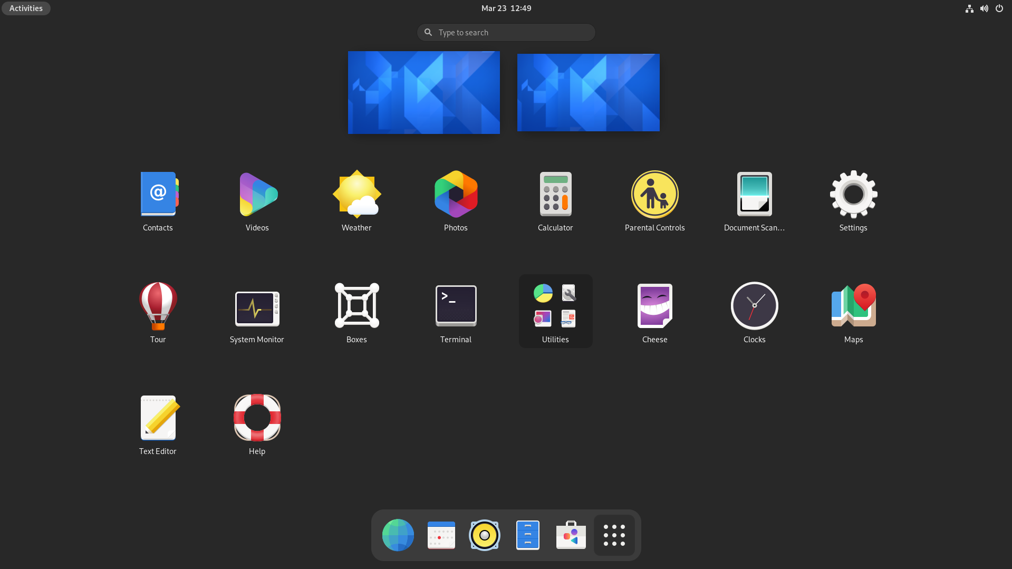
Login steps
login: user1
password:*****
Permission
Denied !!
Authenticated?
NO
/etc/passwd file consulted
/etc/shadow file consulted
YES
“a hello message”
ShellPrompt $
NO
Command Line Interface
GUI?
YES
I’m Logged in!!!
Graphical User Interface
Notes:
Linux and Unix are multi-user systems, meaning multiple users can access the system simultaneously. Each authorised user is assigned a username and password, which they must enter to log in before interacting with the operating system.
User account and password configurations are stored in system files within the /etc directory. If the provided credentials match the system’s authentication records, access is granted; otherwise, it is denied.
For text-based logins, a login shell (CLI – Command Line Interface) starts automatically. In a GUI environment, a shell does not run by default—users must launch a Terminal manually from the desktop menu. Terminal sessions started from a GUI are typically non-login shells, meaning they follow different initialisation rules than direct text logins.

Slide 6

Text terminals
Linux has seven virtual terminals: When Linux is booted in pure text mode these are tty1 -> tty7
/dev/tty1 (F1) is the main console during boot.
If Linux is Booted in GUI mode one, or two, of these will be overlayed with a GUI screen.
Example: Rocky and Ubuntu have the Main GUI is on F2 but there is also an extra one on F1, but F3 to F6 are text. Please note that F7 is not used at all.
We can switch between the text terminals, by using the <alt> key with the relevant F key: for example: <ALT>-<F3> for tty3.
F1
F2
F3
F4
F5
F6
F7
Notes:
Historically, there are seven virtual terminals that give CLI, or character-based logins, although these can be enabled and disabled by the administrator.
You could choose to use them purely to separate some tasks from the rest of the system.
For example, if you are running a long compilation, you may choose to start it in a separate virtual terminal.

Slide 7
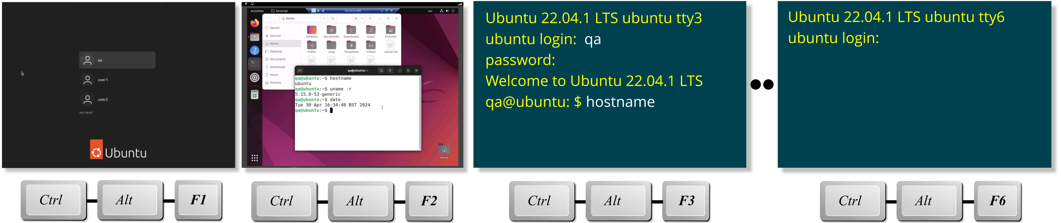
Switching between text and GUI mode
You can switch between GUI and Virtual Text-Console logins
<CTRL>-<ALT>-<F1> to <CTRL>-<ALT>-<F7>
GUI will typically either be <F1>, <F2> or <F7> depending on Distro
<F3> would be for /dev/tty3, F4 /dev/tty4 etc.
Note: When Using VMs or connecting remotely, the RH Control key may need to be used to stop conflict with the local host OS.
Notes:
Linux traditionally provides six virtual terminals for CLI (character-based) logins. These can be useful for isolating the GUI environment from other operations or for separating tasks to improve efficiency.
For instance, if you're running a long compilation process, you can start it in a separate virtual terminal, allowing you to continue working on other tasks without interference. Virtual consoles are ideal for tasks that benefit from a non-graphical environment or require dedicated focus.

Slide 8
UID – User ID
The unique User ID (UID) number obtained during login
from /etc/passwd
Superuser (login name root) has UID of 0
Unrestricted access to the entire system
Take care if you are the superuser
Ordinary users have UID > 0
Restricted to areas and activities for which they have been authorized
Usually, they can only modify the contents of their home directory and the /tmp directory
Notes:
Once a user successfully logs in, the system identifies them by their UID (User ID), a unique number associated with their username. For example, a user named "user1" with the password "notTellin1" might have a UID of 2201. From this point, every action performed by the user is tracked and attributed to their UID.
Users are restricted to actions and resources permitted by their assigned privileges. Linux enforces strict controls to prevent ordinary users from accessing or modifying data, programs, or performing operations for which they lack permission. These safeguards significantly reduce the risk of accidental or malicious damage.
Each Linux/UNIX system also has a special user called the superuser (or root), with a UID of 0, granting unrestricted privileges. The superuser can access, modify, or delete any file or resource on the system, bypassing all normal permission checks. As such, extreme caution must be exercised when operating as the superuser to avoid unintentional system damage.

Slide 9
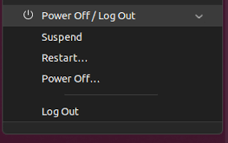
Logging out
bye...
For security and resource usage, always log out when the session is finished.
Never just power a workstation off!
Use the exit command to log off.
Alternatively, send ‘end of input’ signal ( ^D)‏.
User's interactive shell is terminated.
A new login banner shown, ready for the next session.
Ensure proper logout is completed if you use GUI.
The exit command shuts 'current' process only.
Locate 'logout' icon on the GUI panel.
$ exit
login:
login: user1
password:*****
Notes:
To log out of a UNIX system, use the exit command. Alternatively, you can press the Ctrl+D key, which sends an end-of-input signal and is often quicker to type. Once logged out, the system will display a new login prompt, allowing another user to log in from the same terminal.
There are two key reasons to always log out:
System performance: Logging out frees up resources for other users or processes.
System security and data integrity: Leaving an unattended session open poses a serious risk to sensitive data and system security.
Note: The exit command only closes the current shell session. If multiple shell sessions are running, you must exit each one before being fully logged out.

Slide 10
Shells
Command line interface

Slide 11
Introducing Shells: CLI
Shells provide an interface to the system.
No special privileges are required to run a shell
Shells are ordinary programs/apps
Originating from UNIX:
Bourne shell – sh
C shell – csh
Korn shell – ksh
Almquist shell - ash
Popular Linux shells:
Bourne-Again Shell – bash
Tenex C-shell – tcsh
Z-shell - zsh
More about the main shells follow
Hardware
Kernel
Apps/CLI
GUI
Notes:
Shells serve as the interface between the user and the system, allowing users to execute built-in commands and run external programs (more on the distinction between internal commands and external programs later). Traditionally, this interaction occurs via a command line interface (CLI), which is why shells are often referred to by this name.
Creating a shell does not require special privileges – anyone can write their own, and many have. As a result, Linux (and most UNIX variants) offers a variety of shell programs for users to choose from.
In traditional UNIX systems, common shells include the Bourne, Korn, and C shells. On Linux, shells have evolved to become highly developed extensions of these classic UNIX shells. Modern Linux shells can emulate the behavior of older UNIX shells when invoked by alternative names, often achieved through symbolic links (shortcuts).

Slide 12
Bourne Shell (sh)
Developed by Stephen Bourne, at Bell Labs
Work started in 1976
First appeared in V7 of Unix (proprietary)
Goals of the shell were:
To allow shell scripts to be used as filters.
Automation including control flow and variables.
Control over all input / output file descriptors.
Control over signal handling within scripts.
No limits on string lengths when interpreting scripts.
Rationalize and generalize string quoting mechanism.
The environment variables.
Default user shell for BSD UNIX https://en.wikipedia.org/wiki/Bourne_shell
s
h
k
s
h
c
s
h
b
a
s
h
t
c
s
h
Notes:
The Bourne Shell, commonly referred to as sh, was initially developed in 1976 by Stephen Bourne at AT&T Bell Labs. It Qa released IN 1979 and became the default command-line interpreter for Version 7 Unix and served as the foundation for many subsequent shell designs.
Its design emphasised simplicity and scripting capabilities, making it ideal for both interactive use and the automation of administrative tasks. Bourne Shell introduced features like control structures, piping, redirection, and variables, which became essential elements of modern shell scripting.
Although newer shells, such as bash (Bourne Again Shell), have added functionality and replaced sh in most environments, the Bourne Shell's influence persists. It remains the standard for POSIX compliance, ensuring compatibility across UNIX and Linux systems, and its syntax is still widely supported in modern shell interpreters.
Further reading can be found on Wikipedia: https://en.wikipedia.org/wiki/Bourne_shell

Slide 13

C Shell (csh) Tenex shell (tcsh)
Developed by Bill Joy as a student at Berkeley
Work started in 1970s
First appearing in 2BSD in 1978
Goals of the shell were:
It should look more like the C programming language.
Be better for interactive use.
tcsh (Tenex csh):
Created by Ken Greer at Carnegie Mellon University
Began in September 1975 and merged with csh in 1981
Added features like command completion
Default shell for root on BSD UNIX https://en.wikipedia.org/wiki/C_shell
s
h
k
s
h
c
s
h
b
a
s
h
t
c
s
h
Notes:
The C Shell (csh) was developed in the late 1970s by Bill Joy at the University of California, Berkeley. It was introduced as part of the Berkeley Software Distribution (BSD) and became popular for its user-friendly features and C-like syntax, which appealed to programmers familiar with the C programming language.
csh introduced several enhancements over the Bourne Shell, including command history, aliasing, and job control. These features made it easier for users to manage processes and reuse commands efficiently. The shell also provided improved interactive use while retaining powerful scripting capabilities, particularly for those familiar with C-style control structures.
Despite its innovations, csh had limitations in scripting compared to other shells, which led to the development of alternatives like tcsh (an enhanced version of csh). While csh is less commonly used today, its influence on modern shell design and its role in UNIX history remain significant.
Further reading can be found on Wikipedia: https://en.wikipedia.org/wiki/C_shell

Slide 14

Korn Shell (ksh)
Developed by David Korn at Bell Labs
Announced at USENIX 14th of July 1983
Goals of the shell were:
To add more features like those of the C-Shell.
Originally proprietary (not free)
Since ksh93q licenced under Eclipse Public License
https://en.wikipedia.org/wiki/KornShell
s
h
k
s
h
c
s
h
b
a
s
h
t
c
s
h
$ echo $KSH_VERSION
Version AJM 93u+m/1.0.8 2024-01-01
Notes:
The Korn Shell (ksh) was developed in the early 1980s by David Korn at AT&T Bell Labs as an enhanced successor to the Bourne Shell (sh). It combined the scripting strengths of the Bourne Shell with the interactive features introduced by the C Shell (csh), creating a powerful and versatile shell environment.
ksh introduced features such as command-line editing, arithmetic expressions, and improved job control, making it more user-friendly for both interactive use and scripting. It also included advanced scripting capabilities like associative arrays and built-in mathematical operations, which streamlined administrative tasks and system automation.
The Korn Shell became the default shell in many commercial UNIX systems and played a crucial role in defining the POSIX shell standard, ensuring compatibility across different platforms. Although modern shells like bash and zsh have largely replaced it in many environments, ksh remains popular in enterprise settings due to its robust scripting capabilities and performance.
More details can be found on Wikipedia: https://en.wikipedia.org/wiki/KornShell

Slide 15


Bourne Again Shell
Written by Brian Fox for the GNU Project
First released in 1989
As a free replacement for the Bourne Shell
One of the first programs ported to Linux
Bourne Again Shell, a pun on the Bourne Shell
Maintained by Chet Ramey
Goals of the shell were
To be a free shell with lots of features.
The default shell for most Linux distros
Not installed by default on BSD
https://en.wikipedia.org/wiki/Bash_(Unix_shell)
s
h
k
s
h
c
s
h
b
a
s
h
t
c
s
h
$ echo $BASH_VERSION
5.2.15(1)-release
Notes:
The Bourne-Again Shell (bash) combines the features of the three standard UNIX shells – Bourne, C, and Korn – while adding numerous enhancements. When invoked as sh, it can emulate the original Bourne Shell, ensuring compatibility with legacy scripts.
Bash is the default shell on most Linux distributions and is widely available across UNIX systems, making it a practical and versatile choice. For this reason, bash has been selected as the shell for this course.
More detail: https://en.wikipedia.org/wiki/Bash_(Unix_shell)

Slide 16

Almquist Shell (ash)
Written by Kenneth Almquist
First posted in comp.sources.unix on 30th May 1989
Designed as a replacement for the Bourne Shell
Goals of the shell were:
A reimplementation of the System V shell [with] most features of that shell, plus some additions.
Ash is also popular in embedded Linux systems.
s
h
k
s
h
c
s
h
a
s
h
t
c
s
h
Notes:
Almquist shell (also known as A Shell, ash and sh) is a lightweight Unix shell originally written by Kenneth Almquist in the late 1980s.
Initially a clone of the System V.4 variant of the Bourne shell, it replaced the original Bourne shell in the BSD versions of Unix released in the early 1990s.
In 1997 Herbert Xu ported ash from NetBSD to Debian Linux. In September 2002, with release 0.4.1, this port was renamed to Dash (Debian Almquist shell). Xu's main priorities are POSIX conformance and slim implementation.

Slide 17
Z Shell (zsh)
Developed by Paul Falstad as a student at Princeton
Work started in 1990
Named after one of the Lecturer’s, Zhong Shao, computer username
History
zsh was at first intended to be a subset of csh for the Commodore Amiga.
By v1.0 the aim was to be a cross between ksh and tcsh.
In 2019 macOS Catalina Adopted it as the default login shell.
In 2020 Kali Linux adopted it as the default shell.
s
h
k
s
h
c
s
h
z
s
h
t
c
s
h
Notes:
The Z-shell takes the basic Korn shell and provides an enormous number of extensions – the program itself is twice as large as a basic Korn shell.
More detail: https://en.wikipedia.org/wiki/Z_shell

Slide 18
Command line structure
Verb noun paradigm

Slide 19

The command line
The command is the first “word” on the line
Options modify command behaviour: Normally – followed by a character:
Can combine multiple options after one ‘ - ’
Alternatively –– followed by a word
Options have no order, plus can have arguments
Note: Everything is case sensitive.
$ ls -l
$ ls --help
Notes:
Watchout for lowercase L, uppercase i the number one and lowercase I looking that same in certain fonts
Quite often -1 is typed instead of –l due to confusion when reading written instructions due to the font making them look similar.
These slides use a specific font in command examples which helps make them look different.

Slide 20

Anatomy of the command line
Following the prompt, the command line is made of:
The Command (this is the only mandatory part) ls
Some Optional flags:
Short options use – (single dash) -l
Long options use –- (double dashes) --color
If the arguments also start with dashes:
Mark end of options with –– (double dashes)
To avoid these arguments being treated as options
Normally one or more arguments /home/bobby
Typically, these are file and directory names
Terminated by a carriage-return or enter key
$ ls -l --color -- /home/bobby <CR>
Notes:
In many cases, a command will have arguments.These could be objects, typically files, on which the command is to work, and/or options to control the way the command behaves.
The example in the slide shows a number of arguments in applied to the command ls, which is used to list details about files. Without any arguments, ls simply lists the names of all the files in the current directory.
Options are used to modify the way in which a command operates and are usually single characters preceded with a hyphen. The example shows the use of the -l option for the ls commands. The -l option signifies that the output from the command is to be in “long” format, showing more details about each file than just its name.
There is also a -a option which asks ls to show so called 'hidden' files. Options can be combined, and in any order, so ls –la, ls –al, ls –l –a and ls –a –l all do the same thing.
Many programs, particularly those from GNU, now use long options. These are prefixed with two hyphens, and are several characters long, thus they cannot be combined. Like short options, they are not ordered.
Filenames can also be passed to ls as arguments – in which case it lists only the files we have specified.

Slide 21
Entering commands
Both UNIX and Linux are case sensitive.
Commands and arguments are separated by whitespace.
Whitespace characters are tabs or spaces.
Command lines are terminated with <CR>.
The shell will react by interpreting the command.
$ cal
June 2023
Su Mo Tu We Th Fr Sa
1 2 3
4 5 6 7 8 9 10
11 12 13 14 15 16 17
18 19 20 21 22 23 24
25 26 27 28 29 30 31
$ cal 9 2025
September 2025
Su Mo Tu We Th Fr Sa
1 2 3 4 5 6
7 8 9 10 11 12 13
14 15 16 17 18 19 20
21 22 23 24 25 26 27
28 29 30
Notes:
The shell will prompt when it is ready to receive a command.
The default prompt characters (if not overrriden) are:
$ for the Bourne and Korn shells
% for the C shell
# for any shell run by the super user
Most users and distros do not use the default shell prompts.
The shell reads all the characters typed until the Return/Enter (<CR>), key is pressed.
When <CR> is pressed, the shell divides the line into a number of words. Words are separated by white space characters (The first word is interpreted as the command and subsequent words are interpreted as arguments to the command.
As the shell recognises upper-case and lower-case characters, it is possible to have two commands or filenames whose names differ only in the use of case; for example, cal and Cal would be different commands.
The calendar (cal) command outputs a calendar for a named year or month and year. Any year between 1 and 9999 can be given. Use numbers 1 to 12 to specify the month. Try September 1752.
Most commands take arguments, which allow to control the manner of the command behavior and output.

Slide 22

Searching for commands
The shell locates the command after the scan by searching lists of available commands.
The shell searches each list sequentially.
First match forces the command to be executed.
For external commands, a new process is created.
command search sequence in:
command search sequence in:
Internal located in memory
alias
keyword
function
built-in
external programs located on disk
Notes:
When the scan is completed, the shell still has a lot of work to do. Some special parameters will be defined at this stage (more about them later), then the shell will try to locate the command, before eventually the requested command starts up.
The searching for the command is again a very predictable procedure, obeyed by the shell every time. The idea is to make the search most efficient, thus the shell will first check the memory, in case the command is one of the types stored there.
Keywords (or reserved words) are shell’s own programming constructs, like if-then-fi or while-do-done statements. We have already met aliases - they contain call to a command assigned to them. A built-in can be thought of as a subroutine within the shell’s code. The cd, pwd or set commands are examples of built-ins. A function is another definition held in memory, one that contains a script-like content. Locating a command of any of these types is going to be significantly quicker than any search for a command on disk, consequently, when designing a script, it is recommended to use memory-based commands in preference to the external commands (wherever possible).
The PATH variable comes into it only if the shell has exhausted memory searches (unsuccessfully), in which case it will assume that the called command is a program on disk and will search for it by looking into each directory assigned to PATH.

Slide 23
Identify command type
Use type to:
Find out what type a command is, and where the shell is going to locate it.
Also use type to verify names before creating new:
Aliases, functions, and scripts.
which can be used to locate a program in your path.
$ type cd
cd is a shell builtin
$ which ls
/usr/bin/ls
$ type ls
man is aliased to `ls --color=auto’
$ type if
if is a shell keyword
Notes:
The type command is built into the shell and provides information about the nature of commands executed by the shell.
It prints a line that indicates whether the command is:
A reserved word, an alias, an exported alias, a built-in command, an undefined function, a function, a tracked alias, a program on disk, not known
Some systems offer a family of related commands, such as which, whereis and locate.
The whereis command is very useful, as it accepts a filename as argument (rather than just a command name).
For example:
$ whereis passwd
passwd: /usr/bin/passwd /etc/passwd /etc/passwd.old /usr/share/man/man1/passwd.1...
…which shows all files with that name, not just commands.

Slide 24
Special keys
Note: The ^ character means pressing and holding down the Ctrl key.
Use stty tool to check or set/change keyboard mappings.
Key | Action
^H | Delete previous character
^W | Delete previous word
^U | Delete the entire line (prompt not redisplayed)
^C | Interrupt (abort) current command
^D | End of input (often used as logout method)
$ stty -a
intr = ^c; quit = ^|; erase = ^?; kill ^U; eof = ^D
...
$ stty werase \^w
Notes:
Special keys are non-printing characters that have a predefined effect when typed.
The ^H is also backspace key but may be Del key on some systems. It’s a good special key to know when all other methods of wiping a character fail (usually when working with terminal emulator over a network).
The suspend and restart screen output keys (^S and ^Q) are standard ASCII functions available on most, if not all, UNIX systems (and that includes Linux). They are used to stop and start output to the screen when displaying large amounts of information. Linux has a standard mechanism for paging output to the screen, which will be described later.
These special characters are often known as signals. The most popular of them is probably ^C, which allows to get out of a ‘frozen’, misbehaving or plainly unwanted process. The ^D is used to inform an interactive process that no more input data will be forthcoming, i.e., tell is to complete the operation. More about signals later.
The stty command can be used to list and modify or fix the keyboard mappings.
The backslash in the example (2) on the slide allows to type <CTRL-W> without effecting the ^W action at that point.
Alternatively, you could type the example (2) line without the backslash, if you enter the shown characters literally (i.e. using the caret, or <SHIFT-6>).

Slide 25
Knowledge check
What are the parts of a command line?
Notes:
Answers:
The command line is made of:
Command (this is the only mandatory part).
Optional flags:
Short options use – (single dash)
Long options use –- (double dashes)
Normally one or more arguments.
Terminated by a carriage-return or enter key.

Slide 26
Help
Look up things

Slide 27
Getting help
Locally installed documentation:
The traditional help: 'manual pages’
The 'help' command
The 'info’ documentation
The 'doc’ - app documentation under /usr/share/doc
Online:
Forums and variety of web pages exist
Notes:
Linux and Unix, have got several useful tools for finding out how to use command line tools and applications.
The oldest, and arguably most used and respected, is the man command which gives access to an encyclopaedia of information knows as the man pages (located in /usr/share/man).
The info and pinfo commands compliment the man pages by sometimes providing additional information in a more colourful way (located in /usr/share/info).
Applications documentation is often found under /usr/share/doc including README and install, config and user manuals (sometimes in html format).
And of course, there is a huge resource of online help from vendors, blogs and forums.

Slide 28
man
Linux has online documentation: the man pages.
Manual pages are organized in sections:
Section (1) – command line (user) programs
Section (5) – system configuration files
Section (8) – administration and privileged commands
Look for a page using the section number.
passwd(1) is very different to passwd(5)
Default program used to display man pages is less.
Note: You may need sudo mandb to be run once for man –k to work.
$ man ls
get a description of a program
$ man -k edit
locate a command using a keyword
$ man 1 passwd
$ man 5 passwd
Notes:
The man pages, provide the best reference to Linux commands. You may need to refer to the manual pages to determine how a command behaves and what it is used for. The -k option allows you to search database of manual pages for a keyword.
Note: if man –k doesn’t work issue the sudo mandb command on rh variants.
The sections on Linux are:
User commands.
Linux System Calls (for C programmers).
C library functions.
Special files (/dev/*).
File formats and protocols.
Games and "funny little files“.
Conventions, protocols, character sets, file system layout, miscellaneous.
Administration and privileged commands.
You can specify the section number as a second argument to the man program, for example: man 2 write, but usually you do not need to do that.

Slide 29
Man page layout
Key paragraphs in manual pages:
Name command name
Synopsis summary of command line syntax
Description full description of command, options, etc.
Examples examples of use
See Also similar or related commands
Files list of all related files
Note: Occasionally man pages omit some sections.
Notes:
Linux man pages follow a structured format to provide clear and consistent documentation.
Each section serves a specific purpose:
Name – Displays the command name and a brief description of its function.
Synopsis – Shows the basic syntax for using the command, including available options and arguments.
Description – Provides a detailed explanation of the command’s functionality, behavior, and purpose.
Examples – Offers practical usage examples to demonstrate how the command is used in real scenarios.
See also – Lists related commands and documentation that may be useful for further learning.
Files – Mentions configuration or system files associated with the command, if applicable.
This standardized layout makes it easier to quickly find relevant information when working with Linux commands.

Slide 30

Info
GNU Info Command
Alternative, with detail, and probably a nicer UI
Using info pages
Manual pages are the traditional UNIX documentation
The info command is the GNU documentation
Most commands have both man and info
$ info who
...
'who': Print who is currently logged in
...
Notes:
The info documentation system is GNU's alternative to traditional man pages. It often provides more detailed explanations and a more user-friendly tone. However, navigating info pages can feel unintuitive at first.
Here are some useful navigation shortcuts:
Spacebar – Scroll down one screen
Backspace – Scroll up one screen
m – Enter a menu name
n – Jump to the next topic
p – Jump to the previous topic
q – Quit the info pages
Mastering these shortcuts makes navigating info documentation much easier. A more colourful alternative to the info command is the pinfo command, but this might have to be installed before use.

Slide 31
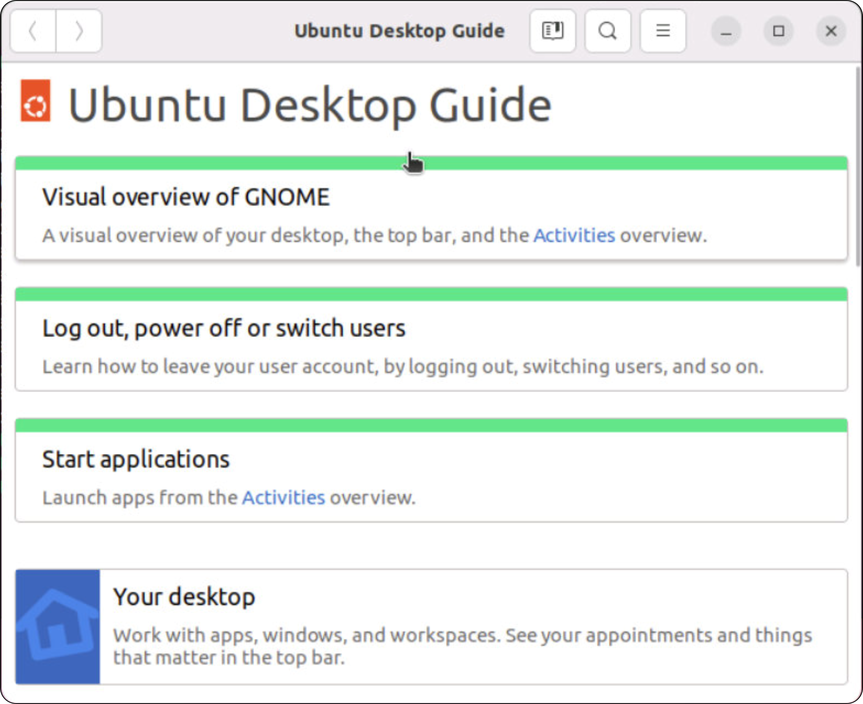
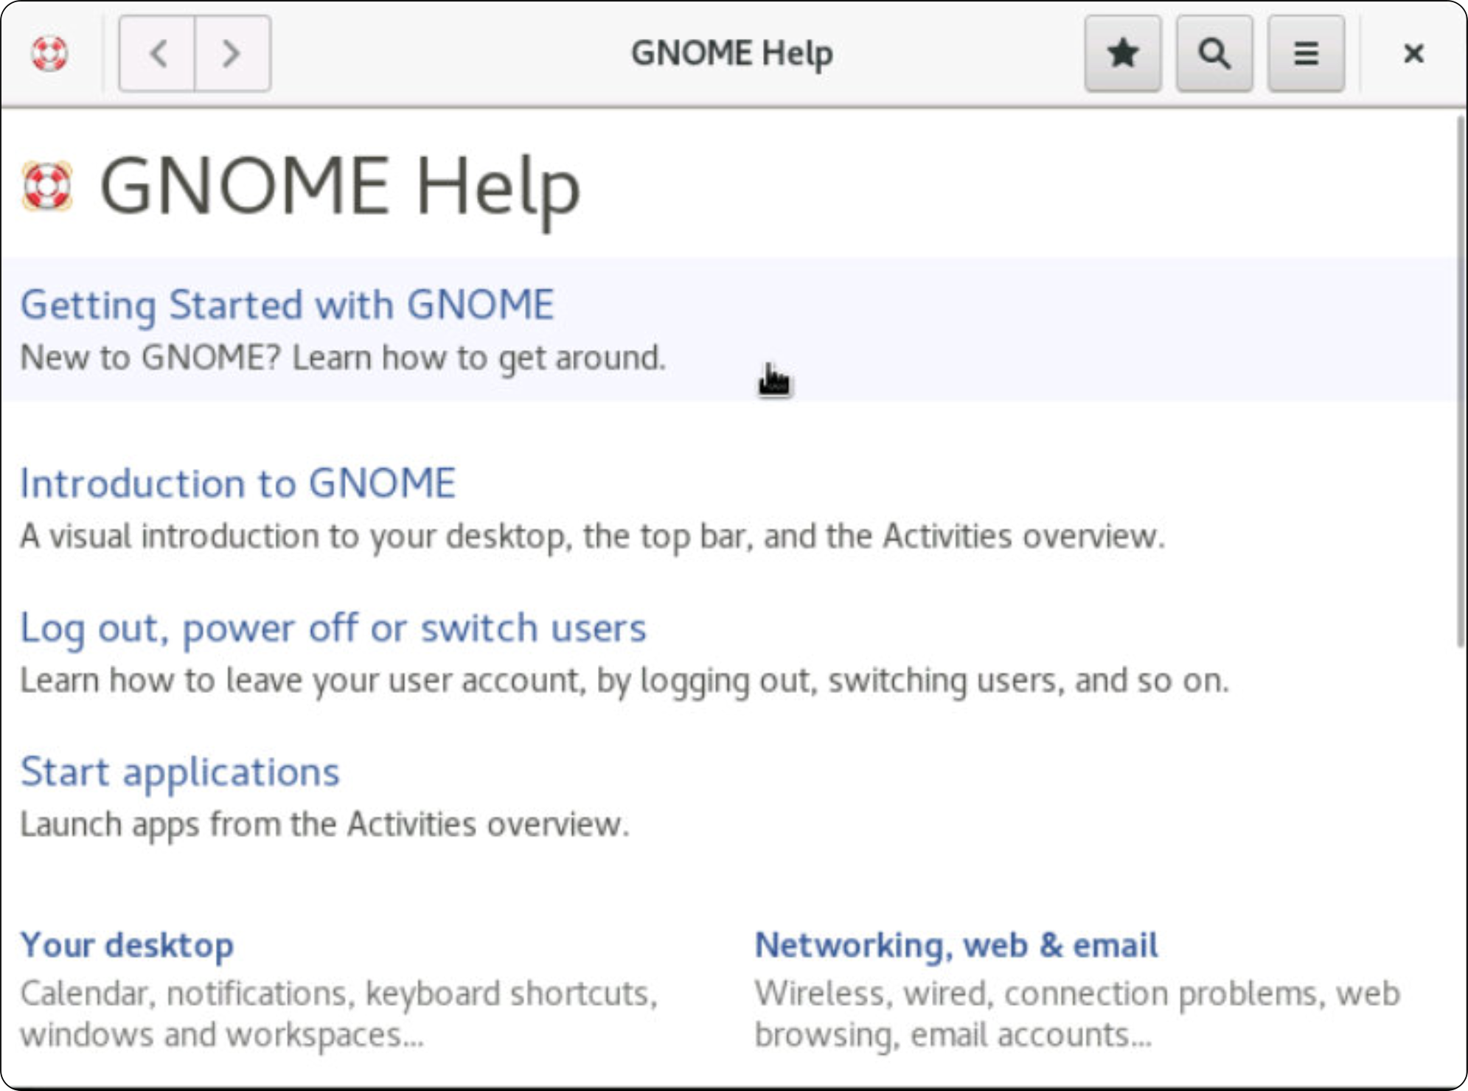
HOWTO and FAQ
Online collection of various documents
HOWTO and FAQs
Program documentation under /usr/share/doc
The Linux Documentation Project: http://www.tldp.org
GNOME Help App
Tips, tricks, and visual overview of your desktop
Notes:
Traditional HOWTO and FAQ documents may no longer be installed by default, as their content evolves rapidly, and the sheer volume of data makes local storage impractical. However, if they are installed, they are typically found under /usr/share.
For the most up-to-date versions, it's recommended to visit The Linux Documentation Project (TLDP) at http://www.tldp.org, which serves as a central repository for Linux guides, HOWTOs, and FAQs.
Additionally, many Linux distributions include the GNOME Help app, which provides a user-friendly way to access system documentation. It integrates with GNOME-based applications, offering quick access to guides, troubleshooting tips, and user manuals.

Slide 32


Websites
What | Where
Linux Forums | https://www.linux.org/
Linux Weekly News | https://lwn.net/
Linux Journal | https://www.linuxjournal.com/
Linux Professional Institute (certifications) | https://www.lpi.org/
The Linux Foundation home site | https://www.linux.com/
Linux news and articles | https://www.linuxtoday.com/
Slashdot - variety of IT resources (not just Linux) | https://slashdot.org/
Dr. Dobbs (resources for developers) | https://drdobbs.com/
It’s Free and Open Source! | https://itsfoss.com/
Linux Hardware Compatibility | https://linux-hardware.org/
Linux hardware and compatibility | https://www.linux-drivers.org/
Download a distro | https://distrowatch.com/
Join the conversation | https://www.reddit.com/r/linux/
OSNews - variety of IT resources (not just Linux) | https://www.osnews.com/
Open Source Software | https://sourceforge.net/directory/
Notes:
There are many good Linux resources online, from journals, blogs, HOWTOs, FAQs and gaming. Click the links and add to your favourites.
Distrowatch is a particular favourite as it has all the latest news and releases in the distro world. And if you keeping on top of your kernel version, then kernel.org will have the latest version to download and compile.

Slide 33


Magazines and downloads
What | Where
Kernel’s main site | https://kernel.org/
Linux Format | https://www.linuxformat.com/
Linux Journal | https://www.linuxjournal.com/
IT news and analysis | https://www.zdnet.com/
InformationWeek (general IT) | https://www.informationweek.com/
Linux Gaming | https://www.gamingonlinux.com/
ArchWiki - FAQs | https://wiki.archlinux.org/title/Main_page
Explain Shell Options | https://explainshell.com/
Crontab guru | https://crontab.guru/
Linux HW reviews (oldest Linux Website) | https://www.phoronix.com/
Not forgetting: https://www.opengroup.org/
Notes:
The list of online websites, magazines for Linux enthusiasts is long and many will have their own favourites. Phoronix is a respected hardware review site for Linux and has been publishing since 2004. The ArchiWiki is the main site for the Archi Linux distro but also has community supported HOWTOs and FAQs that will help users of any distros.
And for those new to the command-line, the Explain Shell site will accept Linux commands and will explain the options provided, whilst the Crontab Guru will explain the format of crontab files – for scheduled tasks.
And the mother of all sites is unix.org which will redirect you to the OpenGroup.org website – the organization that certifies the UNIX trademark, publishes the Single Unix Specification (SUS) and drives the standards in the open-source world.

Slide 34
Lab

Slide 35
Practical exercise 2 – T1
In the accompanying Exercise Guide

Slide 36
Fact finding commands
Find out things

Slide 37
Fact finding commands
Note: Most commands are in lower case
Commands may use additional options or arguments.
Command | Function
ps [options] | Display active processes
date [+format] | Display current time and date
uname [options] | Display basic OS and platform info
who or w | List users logged onto system
df [options] | Show layout of disk filesystems
echo [arguments] | Display arguments on the screen
$ date +%d/%m/%Y
18/04/2023
$ who -H
NAME LINE TIME COMMENT
user1 pts/0 Jan 27 10:15 (Ubuntu2)‏
user2 pts/1 Jan 27 13:57 (Rocky1)
Notes:
This list in the slide shows selected (simple) commands that are just for a brief illustration of using the shell command line. Most of these commands will be revisited and explained more fully further later...
The ps command displays processes. On its own, it shows processes belonging to the user in the current session. The use of options allows to modify the detail that will be displayed, for example ps -e shows all active processes, whereas ps -u bob will show all processes belonging to user bob.
The date command displays time zone, the current date and time.
The uname command displays system information relating to the system hardware platform and the version of the operating system.
The who command lists all users who are logged onto the system. The alternative w command shows not only who is logged on, but also what they are currently doing, as well as system information (equivalent to the uptime tool).
The df command shows the layout (partitioning) of a hard disk and shows the filesystem utilization.
Finally, the echo command simply displays its arguments on the screen; it is often used in scripts. A script is just a text file containing a bunch of commands and program calls (along with flow control programming structures and variables).

Slide 38
System info
Note: Most commands are in lower case.
Commands may use additional options or arguments.
Command | Function
ps [options] | Display active processes
date [+format] | Display current time and date
uname [options] | Display basic OS and platform info
who or w | List users logged onto system
df [options] | Show layout of disk filesystems
echo [arguments] | Display arguments on the screen
$ uname -n
rocky.qaclass.local
$ uname -r
4.18.0-425.3.1.el8.x86_64
$ uname -m
x86_64
Notes:
When working with a Linux system, it's essential to gather basic system information. Here are some useful commands:
hostname – Displays the system’s hostname (network name).
hostnamectl – Provides detailed system information, including hostname, OS, kernel version, and hardware architecture.
uname – Prints system information. Common options include:
-n – Displays the system's hostname.
-r – Shows the kernel release version.
-m – Displays the system's hardware architecture (e.g., x86_64, arm64).
cat /etc/os-release – Provides distribution-specific information, including name, version, and ID. Useful for identifying the Linux distribution.
last – Lists recent login history, showing users, login times, and system reboots. Helps in monitoring user activity.
These commands provide crucial insights into the system’s identity, OS details, and user activity.

Slide 39
Displaying file contents
Tools to display files, usually take filenames as arguments
Command | Action
cat <filename> | Display to end of file (-n gives line numbers)
more <filename> | Page through screens
less <filename> | Page through screens but with more options
head -n X <filename> | Show the first X lines of the file
tail -n X <filename> | Show the last X lines of the file
tail -n +X <filename> | Show the file from line X to the end
$ cat /etc/hosts
127.0.0.1 localhost
192.168.1.1 yogi
[...]
Notes:
When working with text files in Linux, several commands help display file contents efficiently:
cat <filename> – Displays the entire contents of a file in one go. Best for small files.
more <filename> – Displays file content page by page. Press Space to move forward and q to quit.
less <filename> – Similar to more but allows backward navigation with the arrow keys. Press q to exit.
tail <filename> – Shows the last 10 lines of a file by default. Useful for monitoring logs.
tail -n <number> <filename> – Displays the last <number> lines of the file.
head <filename> – Displays the first 10 lines of a file by default.
head -n <number> <filename> – Displays the first <number> lines of the file.
These commands are essential for viewing file contents, especially when dealing with large files or log monitoring. Try them out on small and large files like /usr/share/dict/words.

Slide 40
More text file commands
To filter/process selected data from files
Command | Action
grep ‘pattern’ <filename/s> | Display lines containing requested pattern
wc [-l|w|c] <filename> | Count lines, words, and chars in file
$ wc /etc/hosts
27 120 998 /etc/hosts
$ grep linux1 / etc/hosts
192.168.42.1 linux1.qa.com linux1
Notes:
The grep command is one of the most useful commands for searching a file and printing the lines which match a given string.
The wc (word count) command displays the number of lines, words and characters within a text file, or any combinations of these using the appropriate options.

Slide 41
Review and lab

Slide 42
Review questions
Which is the default shell on most Linux distros?
Which is the default shell on BSD UNIX?
Which pager command is used by the man command on Linux?
Which command shows keyboard control character mappings?
What content type must a file have so that commands such as cat, more, tail, and grep would work correctly?
Which file reading tool is most useful for the purpose of reading system log files (e.g., to read the last few lines of a log file)?
Describe how grep could be useful in reading log files.
Notes:
The Bourne-Again shell, bash.
The Bourne Shell, sh for users and the C-shell, csh for root.
By default, Linux man command uses /usr/bin/less –is to page the information it generates. To confirm this, you can run man man command. Look at the description of the –P option, where all this is explained.
The stty -a command shows current settings for the keyboard control character mappings.
The commands listed in the question all expect to see just plain text.
The tail command allows a quick listing of the last few entries (lines) from a file.
You can filter lines containing a particular string. For example, to find out all logged information about your mouse, you could run: $ grep mouse /var/log/Xorg.0.log

Slide 43
Practical exercise 2 – T2 and T3
In the accompanying Exercise Guide

Slide 44
Summary
Shells
Launch commands
Interpret command lines
Many to choose from including the bash shell
Command line layout
command [options] [argument[s]]
All items on the command line are case sensitive
Convention is command in lower-case
GNU tools
To interrogate the system and read text files
Getting help
Man pages, info docs, and online resources

